Slide 1
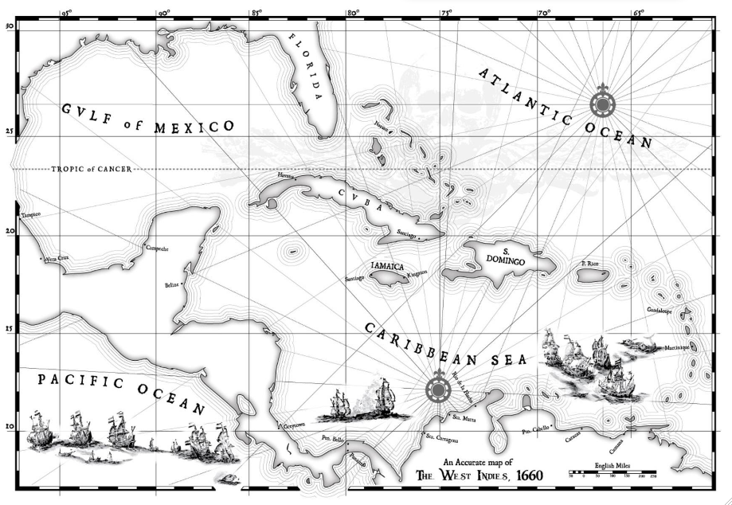
PIRATE TREASURE HUNT
The Mystery of the Linear Inequalities
By Kristan Morales EDUC 523
Click on a link:
Home inequality #1 ineq #2 ineq #3 B triangle quiz help

Slide 2
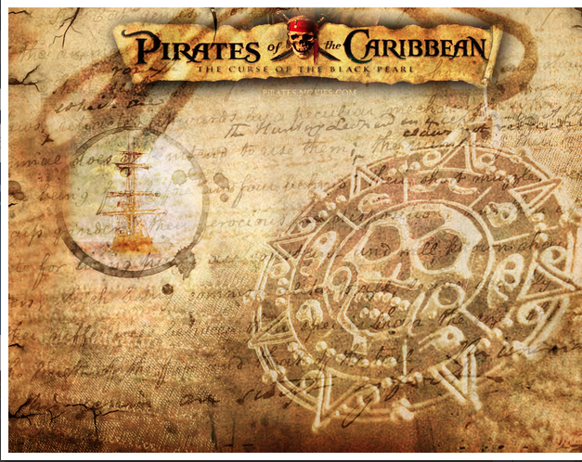
Aayyy Mateys.. Navigation is in order!
You will be going on a Pirate Treasure Hunt in search of Gold and Treasure.
Your task is to chart the open waters of the Caribbean to follow the course of 3 linear inequalities and then find the treasure in located somewhere in the Bermuda Triangle.
You will need to use your Pirate graphing inequalities map making skills to locate the Bermuda Triangle and find the “pieces of eight” gold points inside the Triangle.
Choose a link to begin.
Home inequality #1 ineq #2 ineq #3 B triangle quiz help

Slide 3
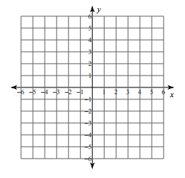
Inequality #1: y< 5x +1
Click to Watch video
Graph and shade Captain Barbossa’s inequality on your graph paper
Click on a link:
Home inequality #1 ineq #2 ineq #3 B triangle quiz help

Slide 4
Inequality #2: y < -2x + 3
Click to watch video
Graph and shade Pirate Angelica”s inequality on your graph paper. Do this on top of Capt Barbossa graph.
Click on a link:
Home inequality #1 ineq #2 ineq #3 B triangle quiz help

Slide 5
Inequality #3: y > 2/5x - 4
Click to watch video
Graph and shade Captain Jack’s inequality on your graph paper. Do this on top of your other 2 graphs and the Bermuda Triangle will be revealed.
Click on a link:
Home inequality #1 ineq #2 ineq #3 B triangle quiz help

Slide 6
The Bermuda Triangle
Now that you have graphed all 3 inequalities on the same piece of graph paper you will have created a triangle region which is the solution set for all 3 inequalities. Highlight that section of your graph in
GOLDEN YELLOW!
Click on a link:
Home inequality #1 ineq #2 ineq #3 B triangle quiz help

Slide 7
Quiz
Find the “pieces of eight” gold by identifying 8 points in your Bermuda Triangle region.
( , ) ( , ) ( , ) ( , )
( , ) ( , ) ( , ) ( , )
List each of the eight points on the bottom of your graph paper with your Pirate System of 3 Inequalities graph and turn it in to Mrs. Morales.
If you are correct you will receive your prize from the Lead Algebra Pirate Mrs. Morales
Click on a link:
Home inequality #1 ineq #2 ineq #3 B triangle quiz help

Slide 8
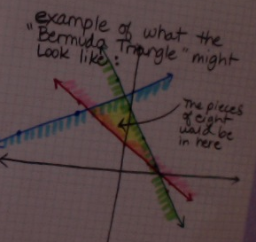
Help
Play video to hear what pirate Morales has to say
Click on a link:
Home inequality #1 ineq #2 ineq #3 B triangle quiz help

