Slide 1
Solving Systems of Linear Equations
By Kristan Morales
EDUC 524-Fall 2 , 2011-Gilbreath
Welcome! Click here to get started

Slide 2
Solving Systems of Equations-Home page
There are 3 ways to solve a system of equations. You will need to take notes on all 3 methods. Once you have done all 3, do the “Try it yourself” problems. When you are done you will have a total of 6 problems to turn into your teacher. Click on the method you want to do first.
1. Solve by Graphing
2. Solve by Substitution
3. Solve by Elimination
4,5,6. Try it Yourself
Click here to exit power point

Slide 3
1. Solve by graphing
x + y = 9
-2x + y = 6
Think How….
When you solve by graphing, 3 things can happen:
The lines intersect in 1 point and that point is the solution.
The lines are parallel, they never cross, so there are no points in common and there is no solution
The lines end up being the same line and have all points in common so there are infinite solutions
Click here so begin graphing
Click to: next home graphing substitution elimination try yourself

Slide 4
1. Solve by graphing
x + y = 9
-2x + y = 6
Let’s get started graphing. Graph the first equation To graph the first equation using slope intercept form,y = mx + b, you will need to solve the
first equation for y
x + y = 9
-x - x
y = - x + 9
slope = -1 y intercept = 9
Click to: next home graphing substitution elimination try yourself

Slide 5
1. Solve by graphing
x + y = 9
-2x + y = 6
Now let’s graph the second equation. To graph the second equation using slope intercept form, y = mx + b, you will need to solve the equation for y
-2x + y = 6
+2x +2x
y = 2x + 6
slope = 2 y intercept = 6
Graph your second equation
on top of your first equation graph
Click to: next home graphing substitution elimination try yourself

Slide 6
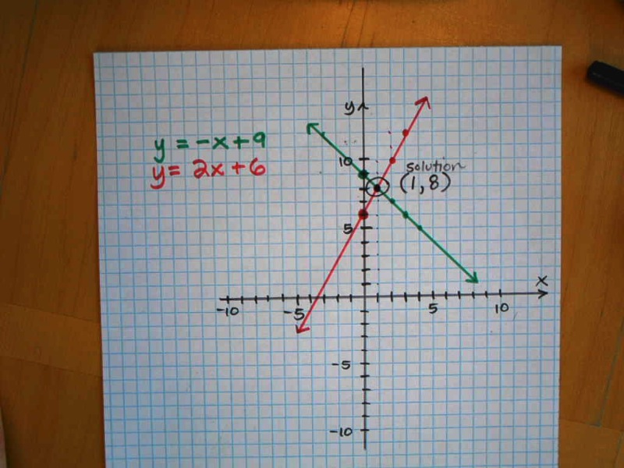
1. Solve by graphing
x + y = 9
-2x + y = 6
The solution to the system is where the 2 graphs intersect. It is the point (1,8).
Click to: next home graphing substitution elimination try yourself

Slide 7
2. Solve by Substitution
x + y = 9
-2x + y = 6
Think How…
Solve one equation for one variable, either x or y
Substitute into your step 1 value for either x or y into your 2nd equation for get a numeric value for one of the variable. This is half of your solution.
Take the number you got in your step 2 and substitute back in to get a numeric answer for your other variable. This will be the other half of your solution and you will be done.
Let’s get started.. Which variable do you want to solve for first? Click on your choice below:
solve for x first solve for y first
Click to: next home graphing substitution elimination try yourself

Slide 8
2. Solve by Substitution- solve for y first
x + y = 9 ------> step 1: y = 9 - x
-2x + y = 6
Step 2: step 3:
-2x + ( 9 – x) = 6 y = 9 - x
-2x + 9 – x = 6 y = 9 - 1
-3x + 9 = 6 y = 8
-3x = -3 SOLUTION ( x, y) = (1, 8)
x = 1
Click to: next home graphing substitution elimination try yourself

Slide 9
2. Solve by Substitution- solve for x first
x + y = 9 ------> step 1: x = 9 - y
-2x + y = 6
Step 2: step 3:
-2( 9 – y)+ y = 6 x = 9 - y
-18 + 2y + y = 6 x = 9 - 8
-18 + 3y = 6 x = 1
3y = 24 SOLUTION ( x, y) = (1, 8)
y = 8
Click to: next home graphing substitution elimination try yourself

Slide 10
3. Solve by Elimination
x + y = 9
-2x + y = 6
Elimination is a process whereby you add the two equations together and magically one variable disappears! Well, its not magic but what you need to do is get the coefficients of one variable to cancel out. For example if I added 3x and -3x together it would equal zero! What would I need to add to 4x to make it equal zero? That’s right! -4x.
What if the coefficients are not opposites? There’s a trick! Multiply one equation by a number so you are set up with opposites that add to zero.
You can choose to eliminate either x or y. Click on your choice below, do whatever seems easiest for you
Eliminate x Eliminate y
Click to: next home graphing substitution elimination try yourself

Slide 11
3. Solve by Elimination-eliminate x
x + y = 9
-2x + y = 6
Step 1: To eliminate x you will need to multiply the first equation by 2 so you get 2x + -2x equals zero.
2( x + y = 9)→ 2x + 2y = 18
+ -2x + y = 6 3y = 24
y = 8
Step 2: Substitute your y value into an equation and solve for x
x + y = 9
x + 8 = 9
x = 1 SOLUTION ( x, y) = (1, 8)
Click to: next home graphing substitution elimination try yourself

Slide 12
3. Solve by Elimination-eliminate y
x + y = 9
-2x + y = 6
Step 1: To eliminate x you will need to multiply the first equation by -1 so you get - 1y + y equals zero.
-1( x + y = 9)→ -1x + -1y = -9
+ -2x + y = 6 -3x = -3
x = 1
Step 2: Substitute your x value into an equation and solve for y
x + y = 9
1 + y = 9
y = 8 SOLUTION ( x, y) = (1, 8)
Click to: next home graphing substitution elimination try yourself

Slide 13
Try it Yourself
Now that you have learned all 3 methods of solving a system of linear equations it is time to 3 problems on your own. You will need to show me what you learned! Are you ready?
Click on each link below and complete 3 problems on your own. Show your work on your paper and be ready to turn it in to your teacher when you are done.
4.Try it yourself – Graphing click here
5.Try it yourself – Substitution click here
6. Try it yourself – Elimination click here
I am finished and ready to turn in my work to my teacher- Click here
Click to: next home graphing substitution elimination try yourself

Slide 14
4.Try it yourself – solve by Graphing
3x + y = 4
2x – y = 6
Remember when you are going to graph using slope and intercept you first need to solve for y = mx + b. The slope will be m and the y intercept will be b. Solve each equation for y and click on the correct response below before you start graphing.
line: 3x + y = 4 line: 2x – y = 6
m = 3 b = 4 and m = 2 b = 6 correct? Click here
m = -3 b = -4 and m = 2 b = -6 correct? Click here
m = 3 b = 4 and m = -2 b = -6 correct? Click here
m = -3 b = 4 and m = 2 b = -6 correct? Click here
Click to: next home graphing substitution elimination try yourself

Slide 15
YOU are CORRECT! Now go ahead and use graphing to solve the system on your paper then Click here to continue
Click to: next home graphing substitution elimination try yourself

Slide 16
Sorry! Click to try again
Click to: next home graphing substitution elimination try yourself

Slide 17
5.Try it yourself – solve by Substitution
-x + y = -8
6x + y = 13
What do you want to do? Click on your choice.
Solve for x first? Solve for y first?
Click to: next home graphing substitution elimination try yourself

Slide 18
5.Try it yourself – solve by Substitution
-x + y = -8
6x + y = 13
You chose to solve for x first. Show your work on your paper and click the correct first step below .
x = y – 8 Correct? Click here
x = -y + 8 Correct? Click here
x = y + 8 Correct? Click here
x = -y + 8 Correct? Click here
Click to: next home graphing substitution elimination try yourself

Slide 19
YOU are CORRECT! Now that you have solved for one variable what you need to do is substitute your value for x into the second equation to get the value for y. That will be half of your answer. Then just take that number and substitute back into first equation to get x which will be the other half of your answer. (x, y) Show your work on your paper and then click here to go to the next problem
Click to: next home graphing substitution elimination try yourself

Slide 20
Sorry! Click to Try again
Click to: next home graphing substitution elimination try yourself

Slide 21
5.Try it yourself – solve by Substitution
-x + y = -8
6x + y = 13
You chose to solve for y first. Show your work on your paper and click the correct first step below .
y = -8 – x Correct? Click here
y = 13 + 6x Correct? Click here
y = 8 + x Correct? Click here
y = -8 + x Correct? Click here
Click to: next home graphing substitution elimination try yourself

Slide 22
YOU are CORRECT! Now that you have solved for one variable what you need to do is substitute your value for y into the second equation to get the value for x. That will be half of your answer. Then just take that number and substitute back into first equation to get y which will be the other half of your answer (x, y). Show your work on your paper and then click here to go to the next problem
Click to: next home graphing substitution elimination try yourself

Slide 23
Sorry! Click here to Try again
Click to: next home graphing substitution elimination try yourself

Slide 24
6.Try it yourself – solve by Elimination
7x + 15 y = 32
x – 3y = 20
You can chose to eliminate either variable first. Remember to “Eliminate” a variable you will add the two equations together and the variable you choose to eliminate will need to have inverse coefficients (for example -4x and 4x) so when you add the two equations together that variable adds to zero and is eliminated. Click on the variable you want to eliminate first
Eliminate x first Eliminate y first
Click to: next home graphing substitution elimination try yourself

Slide 25
6.Try it yourself – solve by Elimination
7x + 15 y = 32
x – 3y = 20
You chose to Eliminate x first.
Q: What do you need to multiply by? A: Multiply 2nd equation by -7 What will happen when you add the two equations together?
a) -6y = 52 click here if correct
b) 36 y = -108 click here if correct
c) 36y = -140 click here if correct
d) -6y = -140 click here if correct
Click to: next home graphing substitution elimination try yourself

Slide 26
YOU are CORRECT!Now that you have eliminated x all you need to do is solve the equation for y. You will then have half of your answer. Substitute that back into either equation and solve for x and you will have both parts of your answer (x, y). Show your work on your paper and click here to continue.
Click to: next home graphing substitution elimination try yourself

Slide 27
Sorry! Click here to try again
Click to: next home graphing substitution elimination try yourself

Slide 28
6.Try it yourself – solve by Elimination
7x + 15 y = 32
x – 3y = 20
You chose to Eliminate y first.
What do you need to multiply and what will happen when you add the two equations together?
a) 8x = 52 click here if correct
b) 12x = 52 click here if correct
c) 8x = 132 click here if correct
d) 12x = 132 click here if correct
Click to: next home graphing substitution elimination try yourself

Slide 29
YOU are CORRECT!Now that you have eliminated y all you need to do is solve the equation for x. You will then have half of your answer. Substitute that back into either equation and solve for y and you will have both parts of your answer (x, y). Show your work on your paper and click here to continue
Click to: next home graphing substitution elimination try yourself

Slide 30
Sorry! Click here to try again
Click to: next home graphing substitution elimination try yourself

Slide 31
I am done! Hurray!
I solved the original problem 3 ways (graphing, substitution and elimination) AND I completed all 3 “try it yourself problems. I have 6 problems worked out on my paper and am ready to turn it in to my teacher.
How did you like learning this way? What worked for you? What confused you? Write a short paragraph about your learning experience at the bottom of your paper.
Click to: next home graphing substitution elimination try yourself

